Slide 1



Campsite booking
Presented by:
Bhagyalakshmi Bheemaraju
Revuri Varshitha
Maheshkar Soumya
Alamanda Harika
Rayavarapu Leela Prasanna

Slide 2
Contents
Overview
Road Map
Plan
UML Diagrams
Modules
Project Structure
Exceptions
Conclusion

Slide 3
overview
The Aim of this application is to book a CAMPSITE in a small island.
The user can be reserved to maximum of 3 days and minimum of 1 day ahead of arrival and up to one month in advance.
The user will provide his/her email & full name at the time of reserving the campsite along with intended arrival date and departure date.
The user have a unique booking Id identifier back to the caller if the reservation is successful the unique booking identifier can be used to modify or cancel the reservation later on.

Slide 4
roadmap
Implemented tools:
Spring boot Framework+Core java+JPA with Hibernate+PostgreSQL database
RESTful api Service using rest end points+CRUD , Global Exception Handling+JPQL , Customized JPARespository

Slide 5
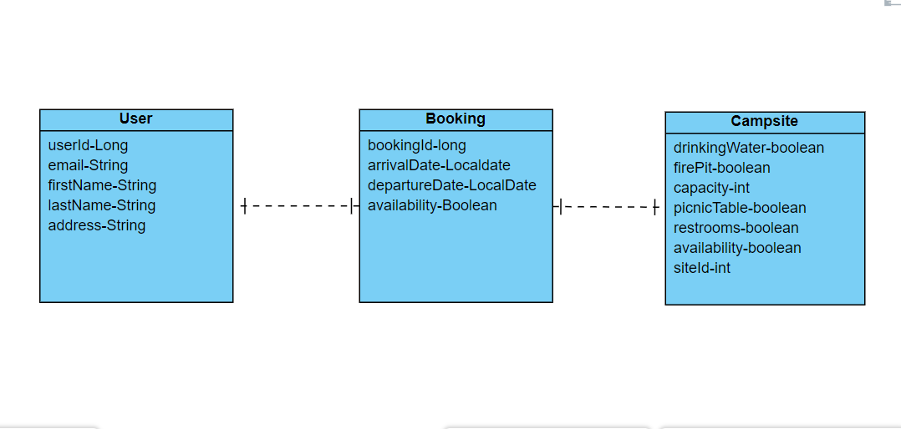
CLASS DIAGRAM

Slide 6
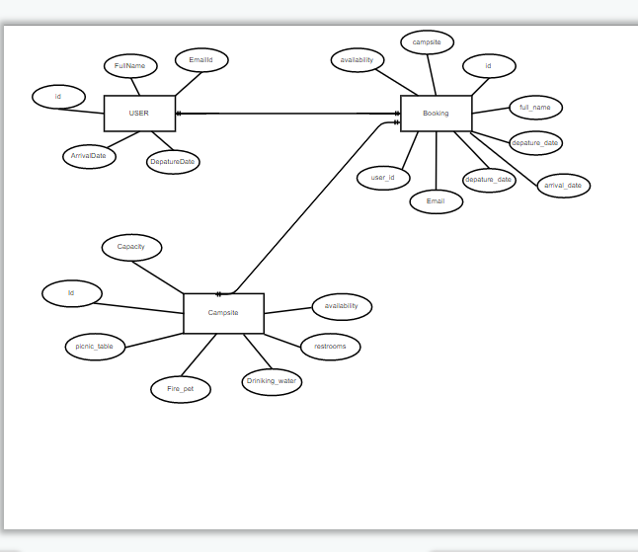
ER DIAGRAM

Slide 7
plan
1. Design
Generate the skeleton as per Key features provided.
2. TDD approach(Test Driven Development)
Identify test cases for each module
Write Failing Test cases
Convert the Test Cases in GREEN
3. Implement the case study in incremental manner

Slide 8
module
USER
BOOKING
CAMPSITE

Slide 9
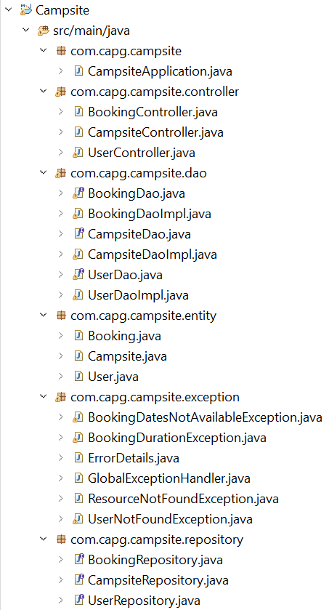
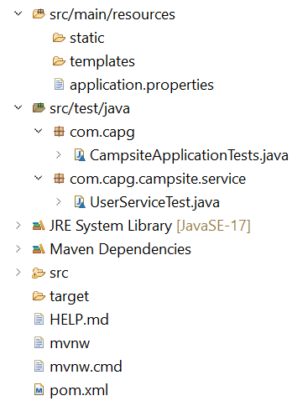
Project structure

Slide 10
exceptions
BookingDatesNotAvailable Exception
BookingDuration Exception
GlobalException Handler
ResourceNotFound Exception
UserNotFound Exception

Slide 11
Thank you

